Slide 1


Using Automation to Achieve Six-Sigma Quality and Improve Patient Safety
Charles D. Hawker, PhD, MBA, FACB
Professor (Adjunct) of Pathology
University of Utah School of Medicine
Scientific Director, Automation & Special Projects
ARUP Laboratories, Salt Lake City, UT
July 26, 2014

Slide 2
Introduction
To repeat what everyone has heard many times:
○ Clinical labs are under increasing economic pressure…
○ which creates demands for improved productivity.
○ In addition, the laboratory workforce is aging, with…
○ an inadequate pipeline of trained replacements.
○ Improving patient safety is a very important goal...
○ which requires continuous improvement in both non-analytic and analytic quality.
In addition to written processes, training, checklists, vigilance, etc., continuous quality improvement and process re-engineering, using Lean and Six-Sigma, are needed to improve quality.
Adding automation, robotics, enhanced software, and advanced processes to written procedures, training, checklists, vigilance, etc., is necessary to push non-analytic quality to Six Sigma levels.
However, each lab can implement certain activities to improve non-analytic metrics without an investment in expensive automation. They may not lead to Six-Sigma levels, but these activities can still improve quality. Some examples will be provided.

Slide 3
What is Six-Sigma Quality?
Six-Sigma is a process improvement initiative used to drive defects from processes. The goal is to create near perfection through continuous improvement. It makes heavy use of statistics and the measured quality is usually expressed as defects per million opportunities (DPMO).
Sigma Level DPMO
1 691,462
2 308,538
3 66,807 4 6,210
5 233*
6 3.4
*In our lab sections, the threshold for corrected reports is 2/10,000

Slide 4
Realistic Error Rates: It is difficult to have better than a 1/1000 error rate without advanced design and technology
Best Rate Method of Ensuring Accuracy Example
1/1,000 Clear processes, reliance on Hand washing
education, training, vigilance
1/10,000 The above plus reminders, Requisition order errors checklists, communication, Sub-optimal specimens
retraining, competency testing,
processes reflecting human behavior
1/100,000 The above plus standardiza- Mislabeled specimens
tion, error-proofing, elimina- Corrected reports
tion of fatigue & distractions
1/1,000,000 The above plus automation, Lost specimens
robotics, software enhance- Interfaced result entry
ments, advanced process Bar code reading
design
Source: Michael Astion, Univ. of Washington, based on a report by Resar, RK: Making noncatastrophic health care processes reliable: learning to walk before running in creating high-reliability organizations. Health Serv. Res. 2006;41:1677-1689

Slide 5
Realistic Error Rates: It is difficult to have better than a 1/1000 error rate without advanced design and technology
Best Rate Method of Ensuring Accuracy Example
1/1,000 Clear processes, reliance on Hand washing
education, training, vigilance
1/10,000 The above plus reminders, Mislabeled specimens
checklists, communication, Requisition order errors
retraining, competency testing, Sub-optimal specimens processes reflecting human behavior
1/100,000 The above plus standardiza- Lost specimens tion, error-proofing, elimina- Corrected reports
tion of fatigue & distractions
1/1,000,000 The above plus automation, Bar code reading
robotics, software enhance- Interfaced result entry
ments, advanced process
design
Source: Michael Astion, Univ. of Washington, based on a report by Resar, RK: Making noncatastrophic health care processes reliable: learning to walk before running in creating high-reliability organizations. Health Serv. Res. 2006;41:1677-1689

Slide 10
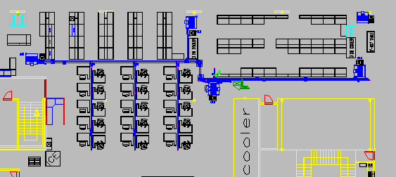
ARUP Automation, November 17, 1998
2000 specimens/hour, 30 workstations, 4 sorters

Slide 13
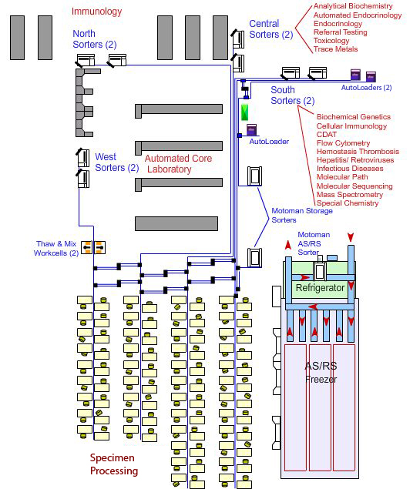

Slide 14
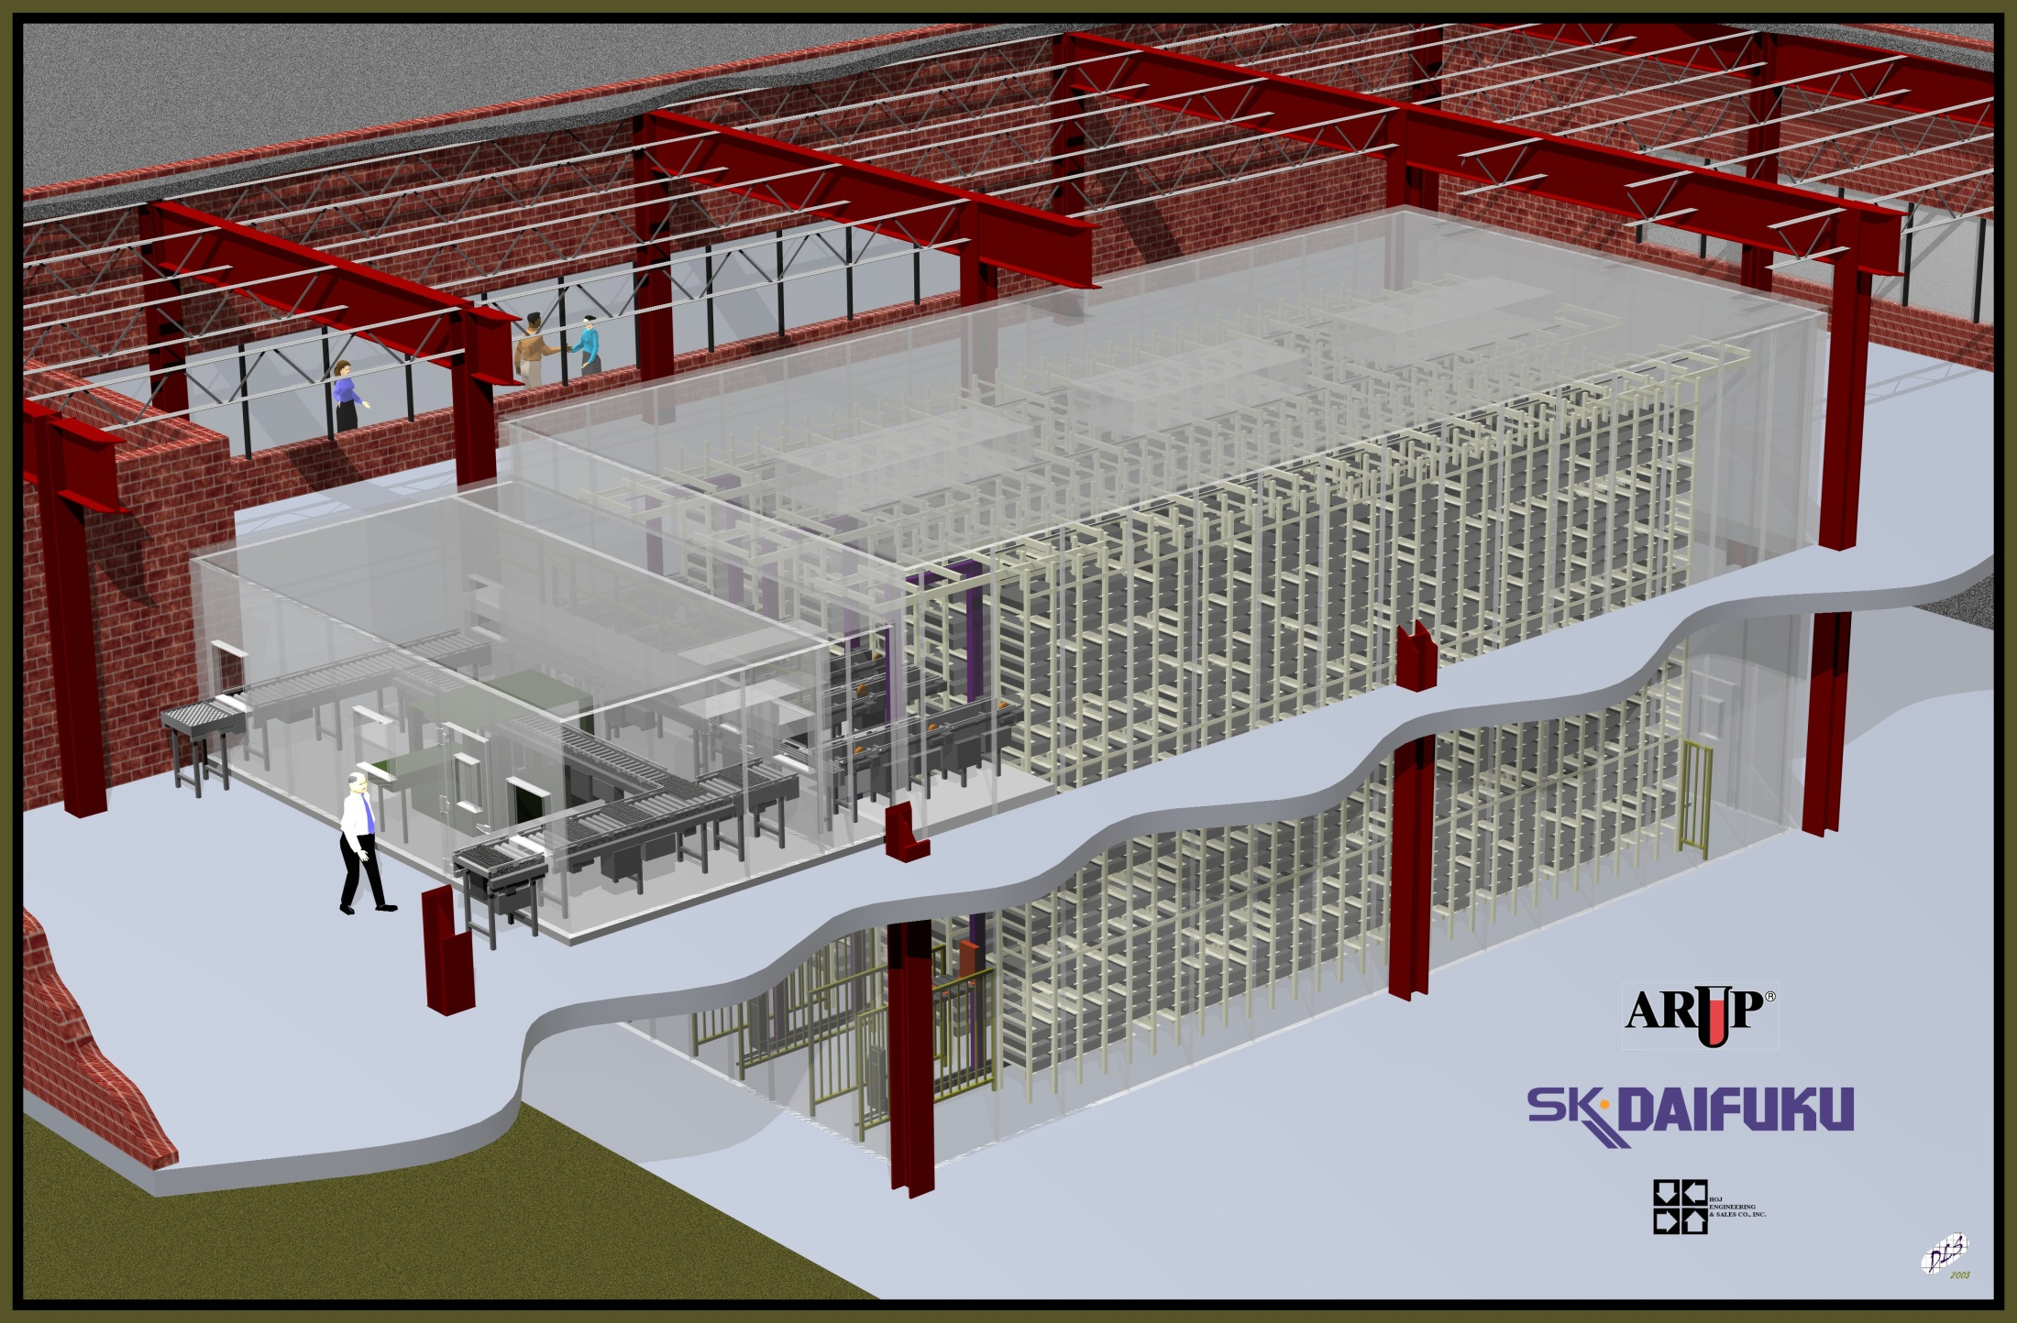

Slide 16
Automation: Sort to Light System
Process Improvement: Specimen Receiving Pods
Five Sigma
Six Sigma

Slide 17
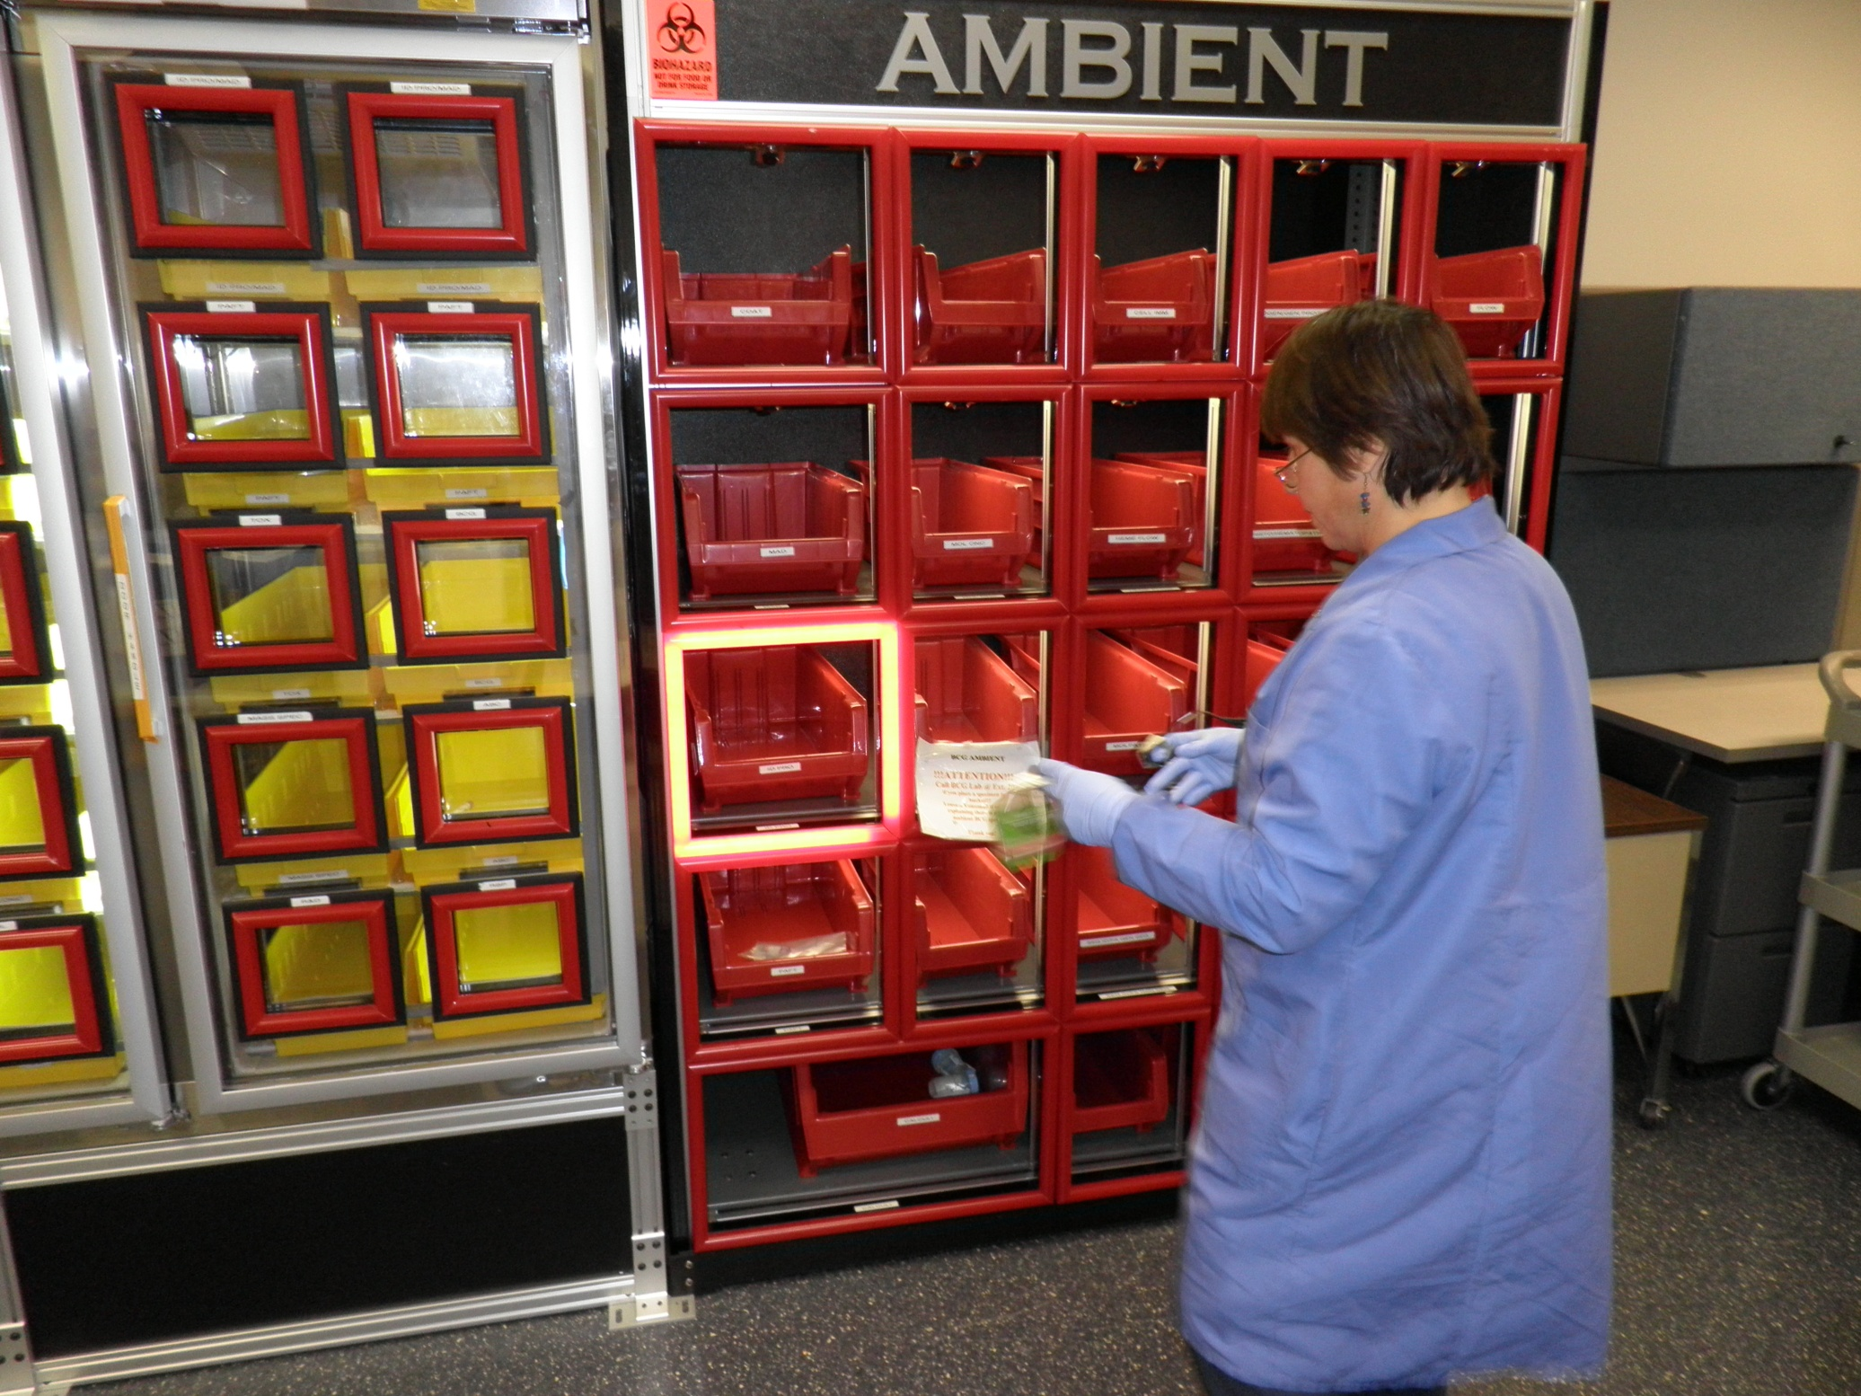

Slide 18
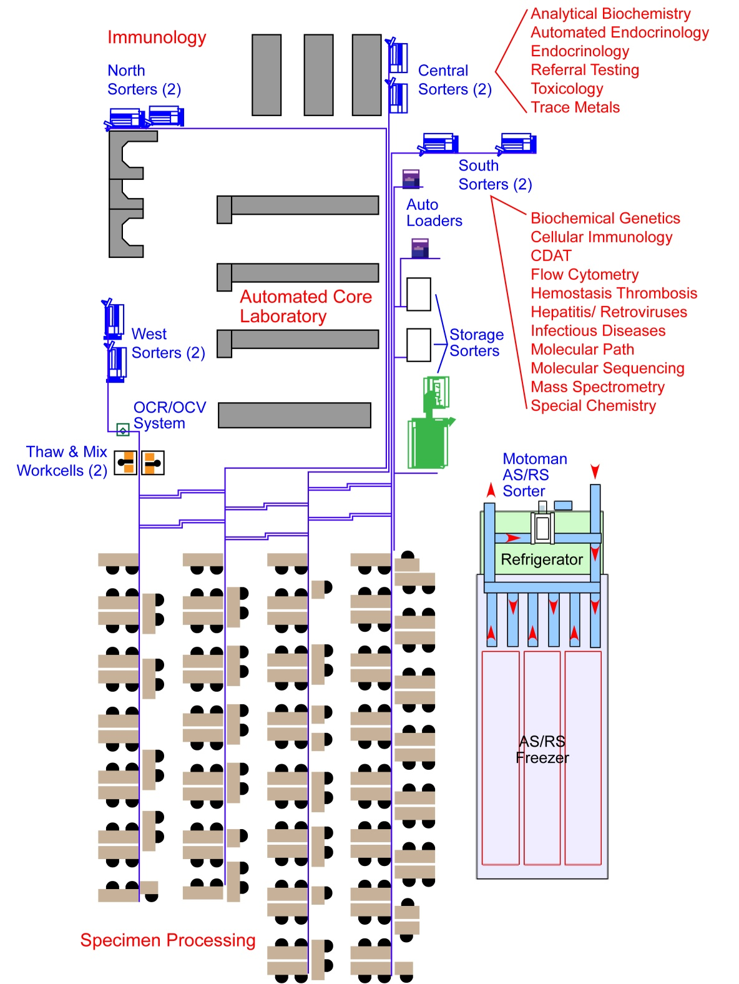

Slide 19
Six-Sigma Analysis
The definition of Six-Sigma is 3.4 defects per million opportunities (DPMO).
In the case of lost specimens, each time a specimen is handled represents an opportunity to lose the specimen.
At ARUP, each specimen has an average of 1.6 billed units (tests). Each test represents a separate handling of the specimen and is thus an opportunity to lose the specimen.
Therefore, for Six-Sigma assessment of lost specimens, using total billed units as a denominator is more correct than using total specimens.

Slide 21
Realistic Error Rates: It is difficult to have better than a 1/1000 error rate without advanced design and technology
Best Rate Method of Ensuring Accuracy Example
1/1,000 Clear processes, reliance on Hand washing
education, training, vigilance
1/10,000 The above plus reminders, Mislabeled specimens
checklists, communication, Requisition order errors
retraining, competency testing, Sub-optimal specimens processes reflecting human behavior
1/100,000 The above plus standardiza- Lost specimens tion, error-proofing, elimina- Corrected reports
tion of fatigue & distractions
1/1,000,000 The above plus automation, Bar code reading
robotics, software enhance- Interfaced result entry
ments, advanced process
design
Source: Michael Astion, Univ. of Washington, based on a report by Resar, RK: Making noncatastrophic health care processes reliable: learning to walk before running in creating high-reliability organizations. Health Serv. Res. 2006;41:1677-1689

Slide 22
Mislabeled Specimens in the US and ARUP
Mislabeled lab specimens are a significant element of US patient errors, ranging from 0.04% to 5% in different studies.
In an early CAP Q-Probe study of 120 reporting institutions, Valenstein and Raab, et al, [Arch Pathol Lab Med. 2006;130:1106–1113] reported a median incidence of mislabeled specimens of 0.39 per 1000.
Another CAP Q-Probe study of 147 reporting US clinical labs showed an average incidence of mislabeled specimens of 0.9 per 1000 [Wagar, et. al., Arch Pathol Lab Med 2008; 132(10):1617-22].
A third CAP Q-Probe study of 122 reporting US blood banks showed an average incidence of 1.12% mislabeled specimens [Grimm, et. al., Arch Pathol Lab Med 2010; 134(8):1108-15].
At ARUP, our historic measured error rate in Specimen Processing has been ~1 per 10,000, or about 1/4 to 1/10 the above published US error rates. Of those, we believed that our “down stream” inspections in the lab sections were finding and correcting ~95%.

Slide 23
The Cost of A Mislabeled Specimen
According to a published citation (Kahn, et al 2005*), the average total of hypothetically incurred charges of a mislabeled specimen is $712 at 2005 cost levels, not including patient anxiety and discomfort and delays in diagnosis and treatment, had the patients or payers been billed for any required additional charges to resolve the mislabeled specimen. They were not actual incurred costs.
Per the CAP website cited below, if the median estimate of Valenstein and Raab (previous slide) of 0.39 mislabeled specimens per 1000 is multiplied by the $712 in hypothetical costs, misidentified specimens can add as much as $280,000 in costs to the healthcare system for each million specimens tested.
*http://www.cap.org/apps/portlets/contentViewer/show.do?printFriendly=true&contentReference=practice_management%2Fdirectips%2Fmislabeled_specimens.html
Or: Laboratory Medical DirecTIPs, February 23, 2010, The Problem of Mislabeled Specimens

Slide 24
Cognex Omniview System
The Cognex Omniview system has four 5-megapixel high speed cameras which photograph the tube’s exterior from all sides after it is robotically lifted out of the transport carrier. The software stitches the four images together into a two dimensional image. A sophisticated OCR engine analyzes the label content, comparing the patient name on the client label to the patient name in the ARUP LIS.

Slide 27
How the OCR System Classifies Images
If a character string is found on the client label that is an exact match for what is in the patient name field in the LIS, the image is a “pass.”
If there is only a single label on the specimen tube, the image is an automatic pass (pass as a single).
If no exactly matching character string can be found on the client label, the image is a “fail.”
There are many reasons for fails – poor label quality, unusual fonts, name partially covered by handwriting or by the ARUP label, truncations, names turned 90°, colored labels, striped labels, etc.
Human inspection of all fails is required.

Slide 28
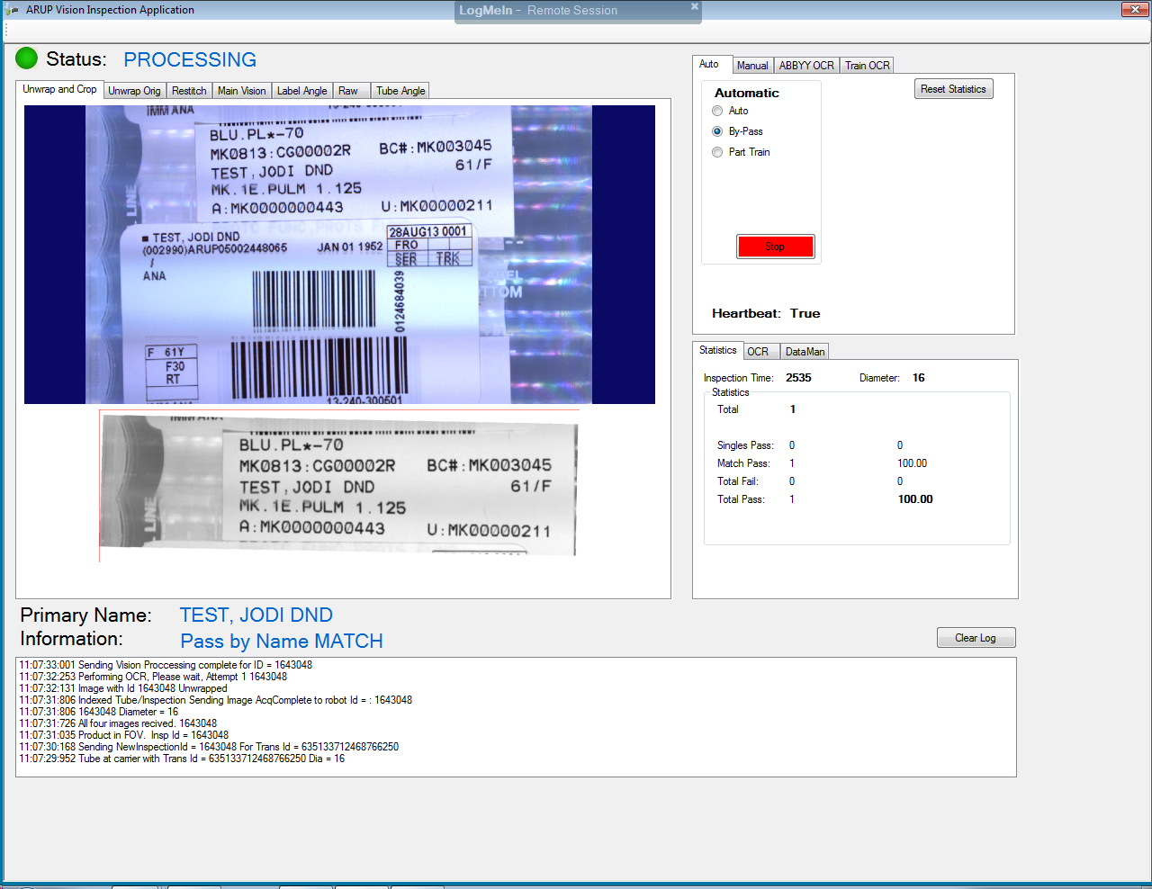
Label Inspection Result is “Pass”

Slide 29
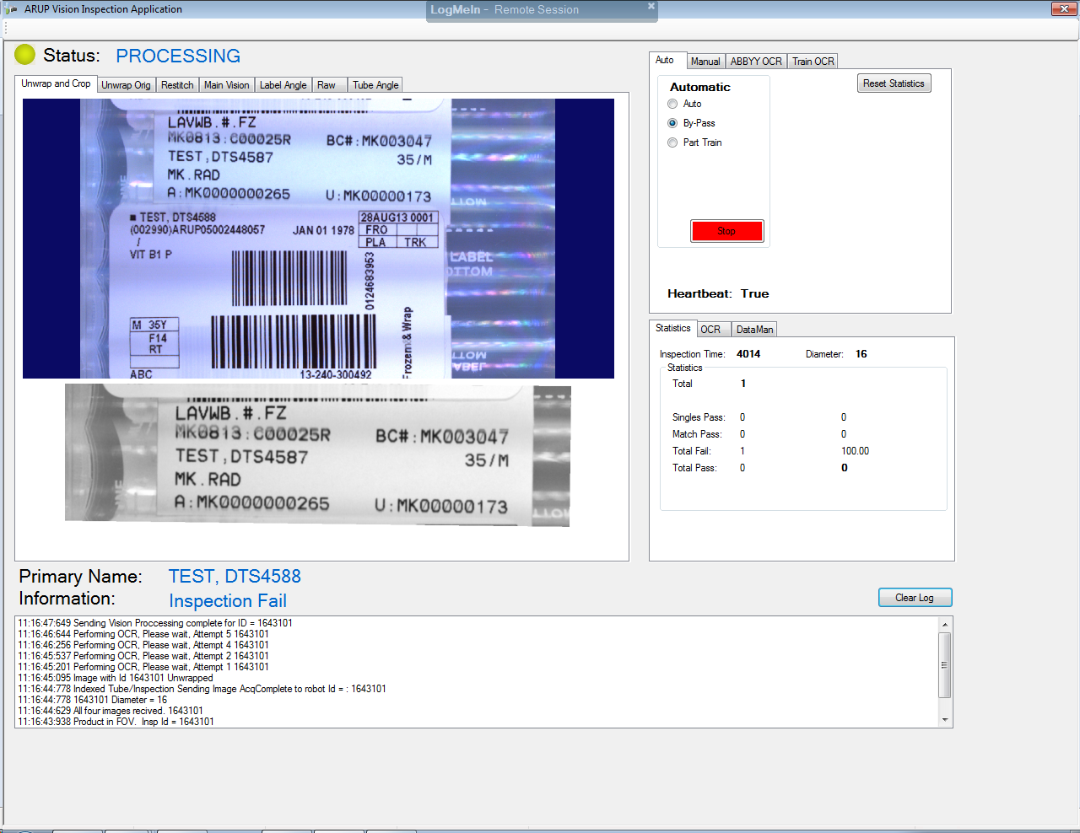
Label Inspection Result is “Fail”

Slide 30
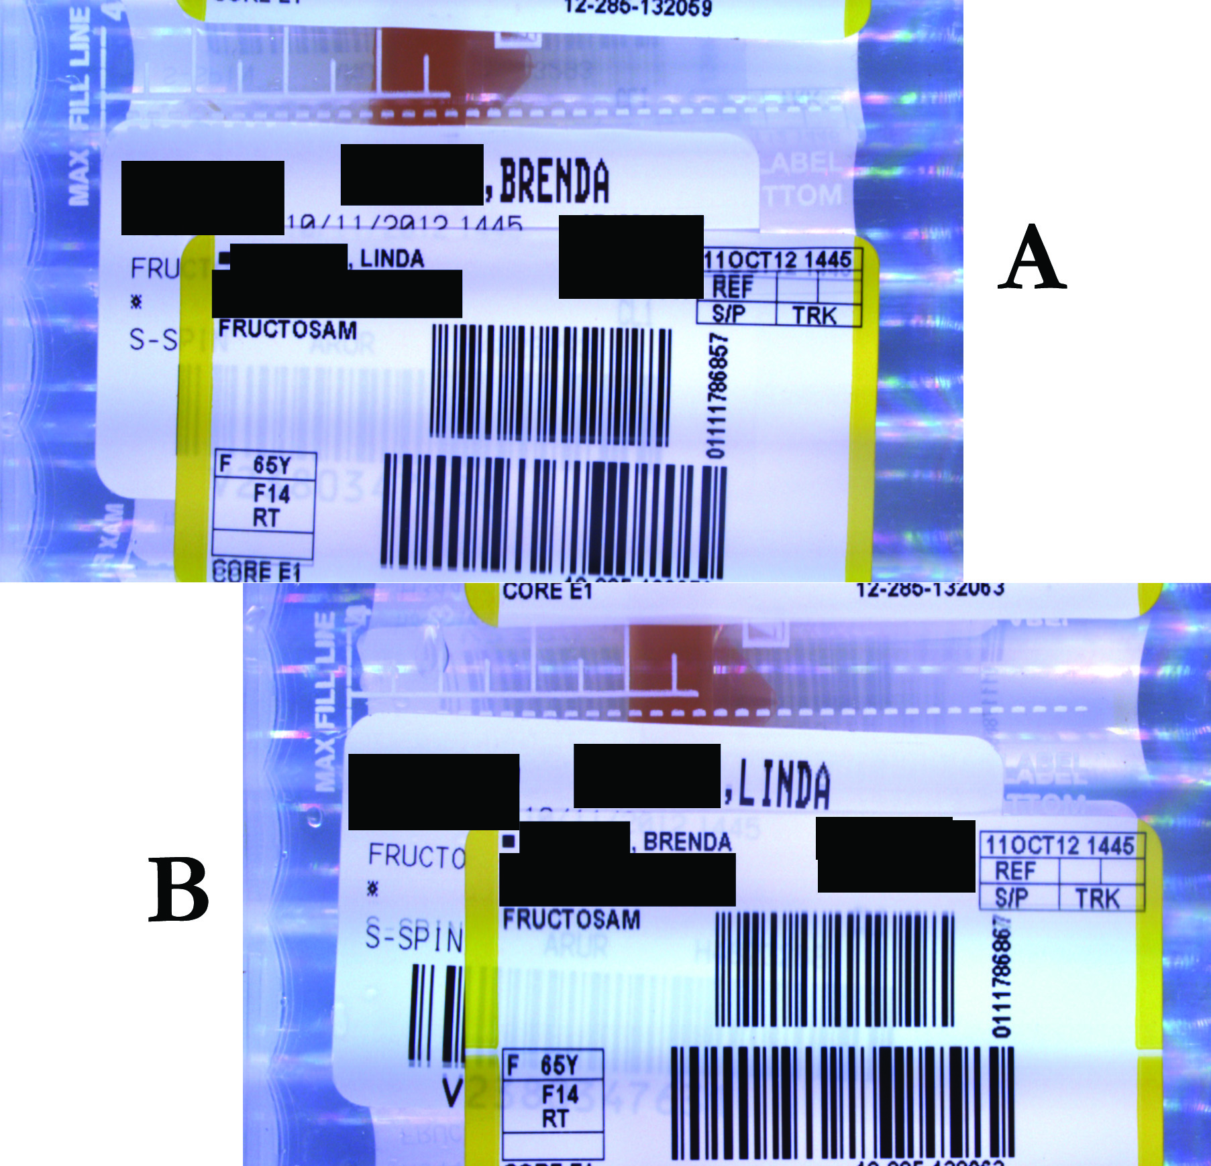
First Mislabeled Specimens Caught by the OCR System

Slide 31
Objectives of Validation Study
Minimize the total number of tubes that fail due to label quality, font training, incorrect positioning of ARUP label over client label, etc. (FALSE FAILS).
All fails require human inspection (manual work). Target 20%
In other words, maximize the correctly labeled tubes that are that are passed by the system (TRUE PASSES). Target 80%
Guarantee that all mislabeled tubes will be failures (TRUE FAILS) and manually inspected. Target 100%
Guarantee that no mislabeled tubes will ever be automatically passed (FALSE PASSES). Target 0%

Slide 32
Validation Study
Images for 1,009,830 specimens (the goal was one million) were obtained as of May 31, 2013. Every image was reviewed.
The OCR system’s “pass” rate of specimen labels on which the patient name can be optically read and verified by the system is ~75%. Long term we expect to achieve >80%.
No false passes i.e., no mislabeled specimens were passed by the system out of 742,977 passes.

Slide 33
Mislabeled Specimens in the Validation Study
Among the images “failed” by the system, 121 mislabeled specimens were found (1 per 8346), somewhat higher than the 1/10,000 expected based on historical data.
Of these 121 mislabels, 71 were found by the testing lab or editors before testing. Investigations for possible corrected reports were initiated on 46 errors not found prior to testing. A total of 21 corrected reports were sent to clients, a rate lower than expected based on prior data.
An additional 148 specimens were identified as “mismatched.” The patient was correct, but a spelling discrepancy in the name requires (per our policy) that the client to be called to verify that the patient and spelling are correct. Only 46 of these minor errors were found by editors prior to testing.

Slide 34
Publication
Invention and Validation of An Automated Camera System That Uses Optical Character Recognition to Identify Patient Name Mislabeled Samples
Charles D. Hawker, William McCarthy, David Cleveland, Bonnie Messinger
Clinical Chemistry, March 2014, Vol 60 (3): 463-470
Accompanying Editorial:
Automated Specimen Inspection, Quality Analysis and its Impact on Patient Safety: Beyond the Barcode
Robin A. Felder
Clinical Chemistry, March 2014, Vol 60 (3): 433-434

Slide 35
Current Results
With the validation study now complete, “pass” images are no longer reviewed – only “fail” and “single” images.
As of May 19, 2,870,849 images have been collected.
Of these, there have been 382 mislabels, a ratio of 1 per 7515 specimens. Only 207 (54%) were found by the testing lab or S.P. employees before testing.
819 specimens were identified as “mismatched.” Only 231 (28%) of these minor errors were found prior to testing.
As of May 19, 40 corrected reports have been sent to clients.
Of these, 17 were Core Lab specimens (prior to 2/18/13), whereas the other 23 were Immunology specimens.
17 ECRs / 636,064 images (Core Lab) = 1 ECR/37,416 images
23 ECRs / 2,234,785 images (Immuno)= 1 ECR/97,165 images

Slide 36
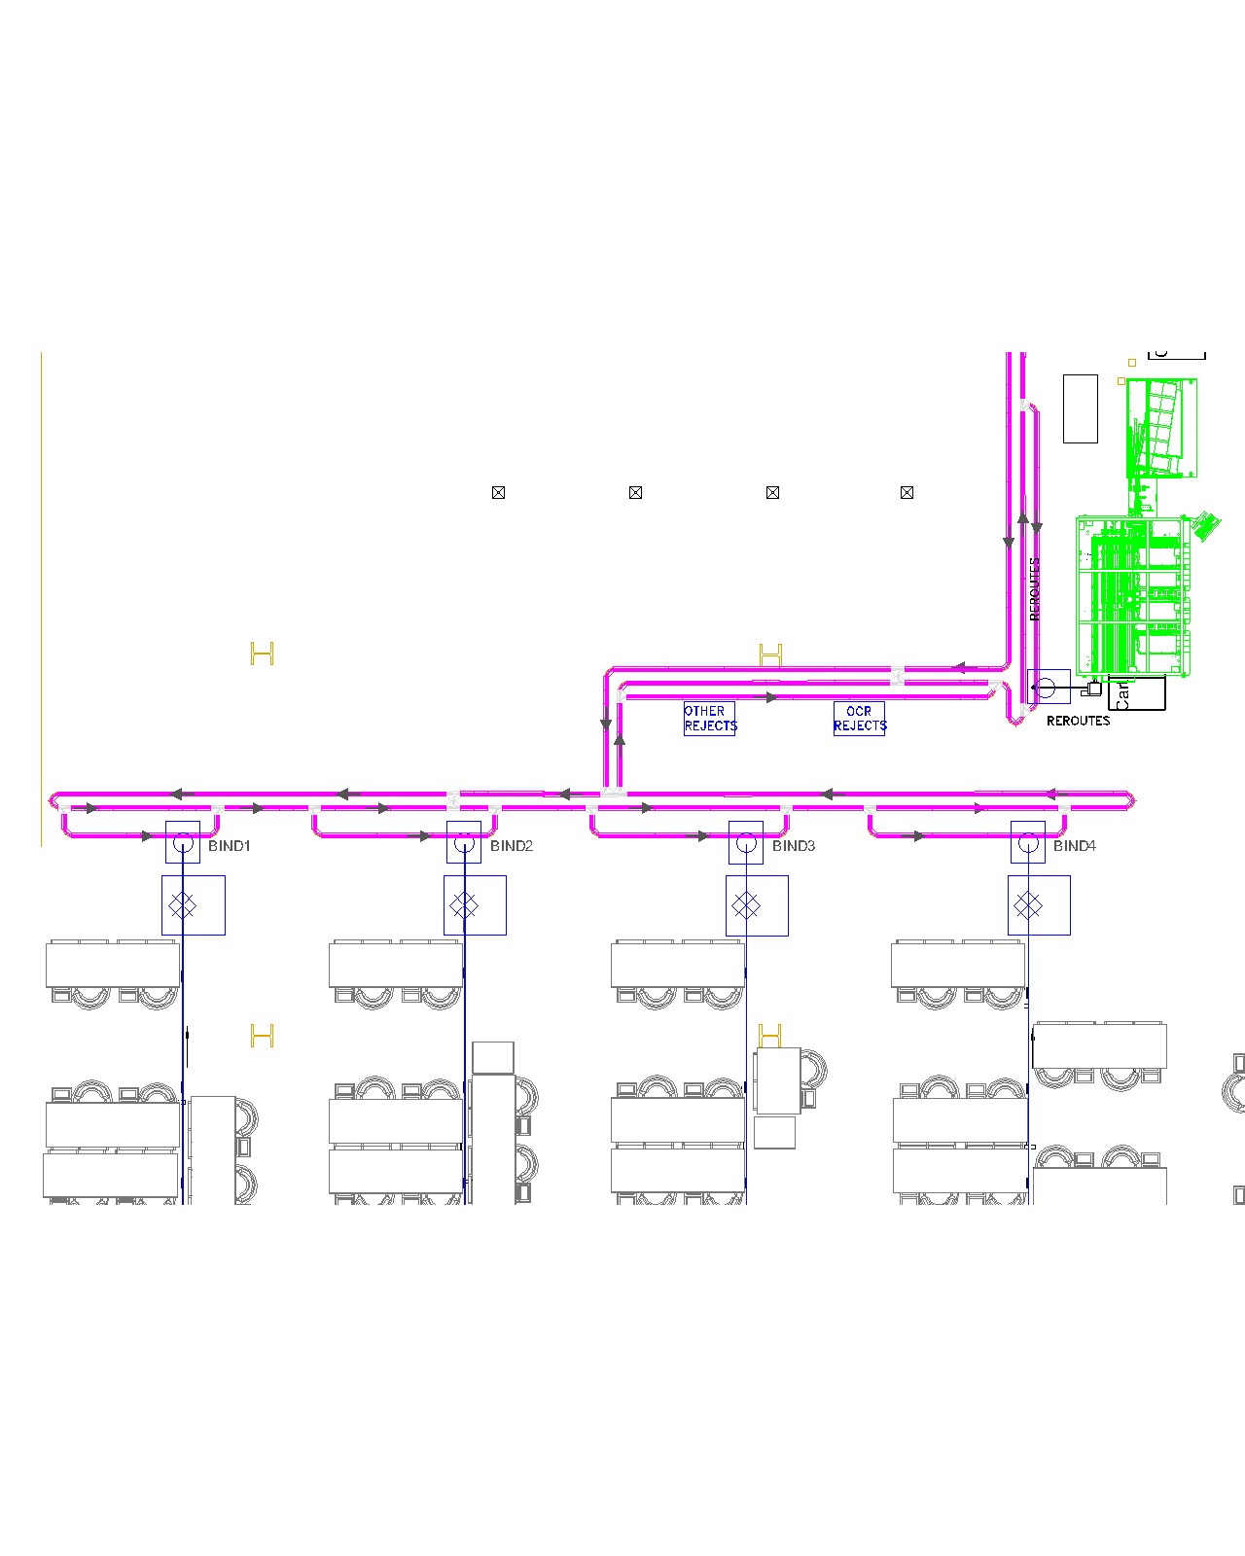
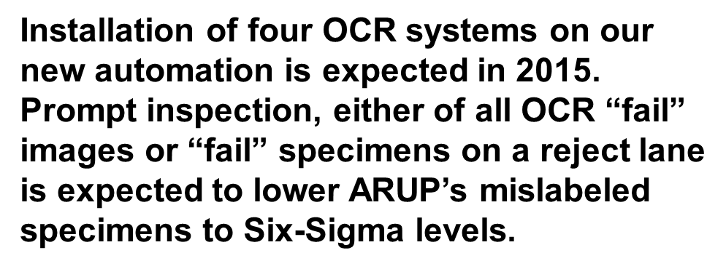
←
←
←
←

Slide 37
What You Can Do In Your Lab
Reducing lost specimens is about tracking, even without automation.
The LIS can be used to track specimens from Specimen Processing (Central Collect status) to lab sections (In Lab status). It requires an extra bar code read in the labs to verify the receipt of the specimen.
For specimens being transported to the lab from clinics or affiliated hospitals, consider using bar codes to create transfer lists.
Require employees to “check out” specimens from a centralized storage system for archived specimens before giving them the location (box/rack #, row #, column #).
Mislabeled specimens can be reduced by using a wireless bed-side phlebotomy system with LIS query that prints specimen labels after the patient’s wrist band bar code has been read.
Mislabeled specimens can also be reduced by implementing CLSI Standard AUTO12-A on Specimen Label Formats.

Slide 38
CLSI Standard AUTO12-A

Slide 39
Summary
Our experience over 22 years in implementing process improvements and automation has led to a steady reduction in lost specimens to a level consistently below 1 per 100,000 billed units and, in some months, in the Six-Sigma region (≤ 0.34/100,000).
New OCR technology for identifying possible mislabeled specimens also has the prospect of achieving Six-Sigma quality levels when fully implemented on our automation.
Several improvement suggestions were offered for laboratories that can offer opportunities to achieve meaningful reductions in error rates, without the cost of expensive automation projects.

