Slide 1
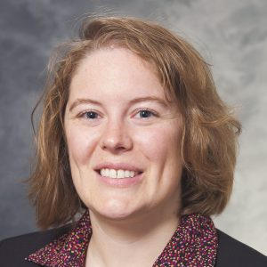
Unique Publishing Opportunities with AACC
Sarah Hackenmueller, PhD, DABCC
Chair, SYCL Core Committee
Director of Clinical Chemistry and Toxicology
Assistant Professor (CHS)
Department of Pathology and Laboratory Medicine
University of Wisconsin

Slide 2
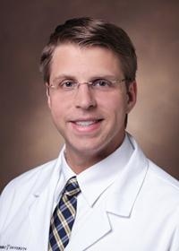
Joe Wiencek, PhD
CCTC Coordinating Committee
Assistant Professor of Pathology, Microbiology and Immunology
Vanderbilt University School of Medicine
Medical Director, Core Clinical Chemistry and Associate Medical Director, POCT
Vanderbilt University Medical Center, Nashville, TN

Slide 3
Clinical Chemistry Trainee Council
Resources/opportunities to discuss today
Clinical Chemistry Guide to Scientific Writing
Clinical Chemistry Podcasts
The Journal Club
Other available learning resources
Pearls of Lab Medicine
Inspiring Minds
https://www.aacc.org/science-and-research/clinical-chemistry-trainee-council

Slide 4
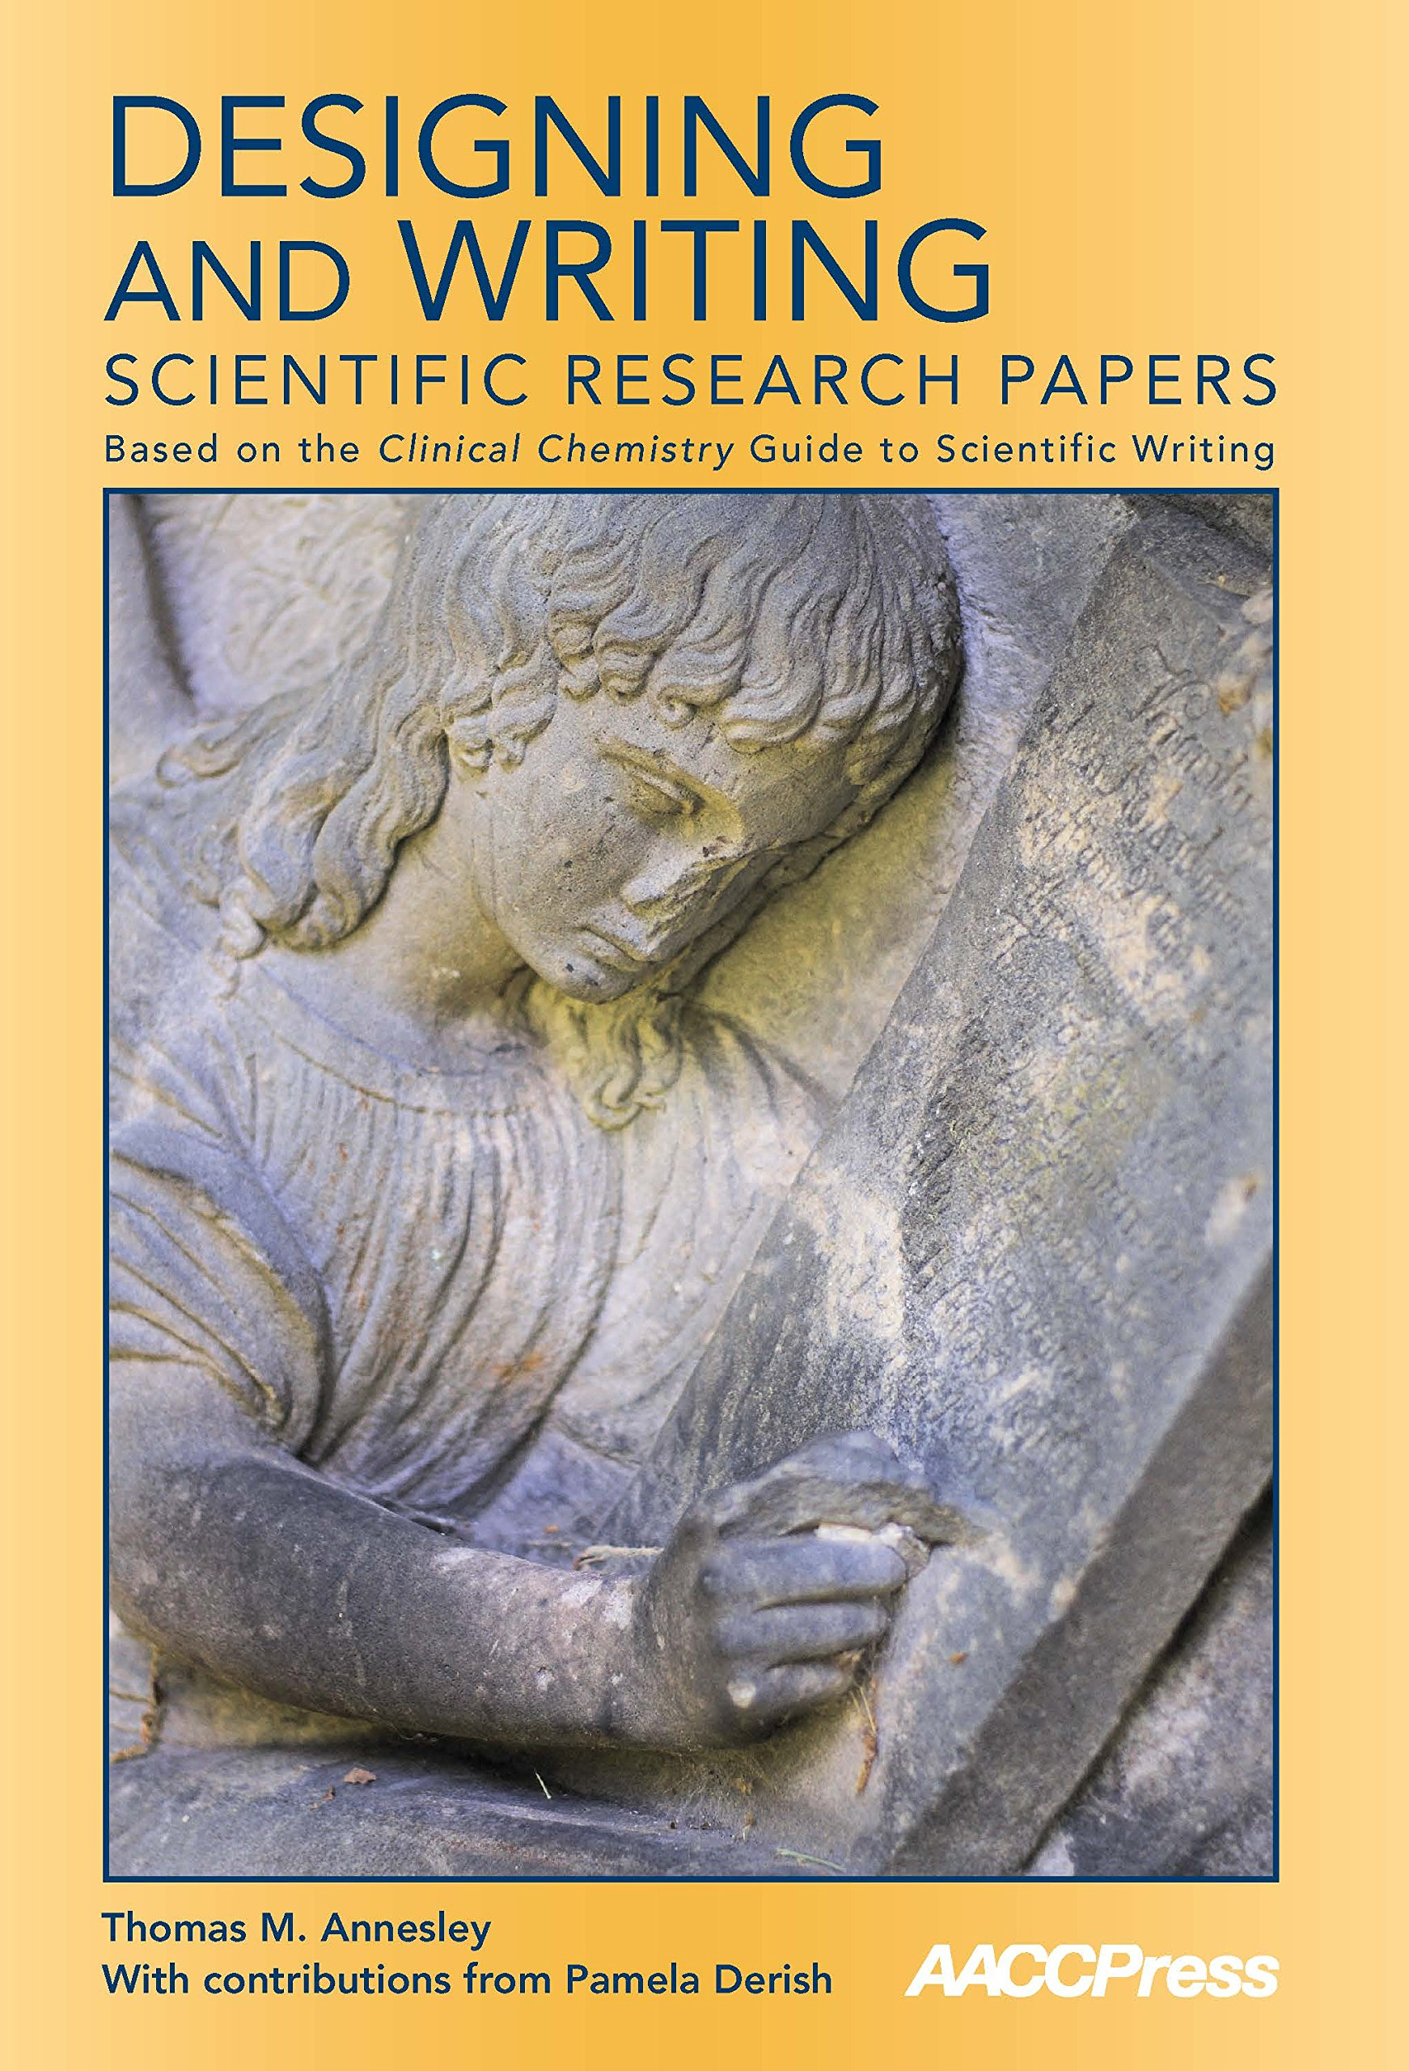
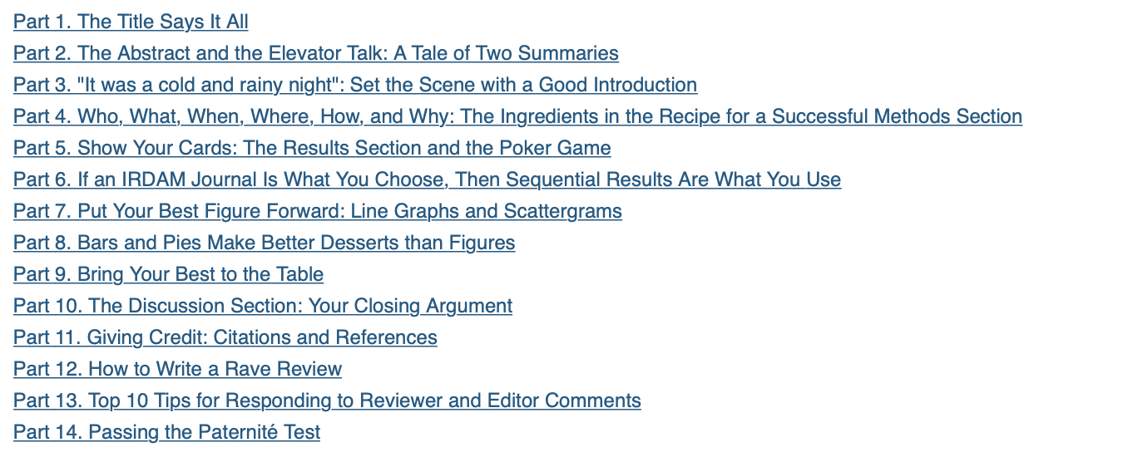
Clinical Chemistry Guide to Scientific Writing
https://www.aacc.org/science-and-research/clinical-chemistry-trainee-council

Slide 5
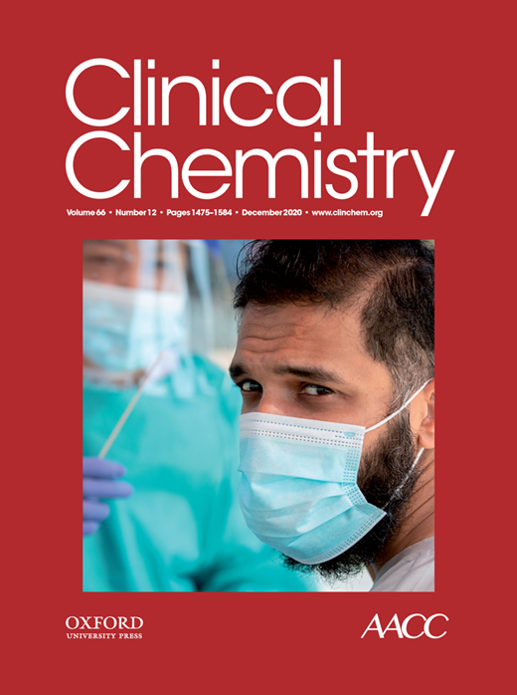
Journal Club
Association between SARS-CoV-2 Neutralizing Antibodies and Commercial Serological Assays
M.S. Tang, J.B. Case, C.E. Franks, R.E. Chen, N.W. Anderson, J.P. Henderson, M.S. Diamond, A.M. Gronowski, C.W. Farnsworth
December 2020
https://doi.org/10.1093/clinchem/hvaa211
© Copyright 2020 by the American Association for Clinical Chemistry

Slide 6
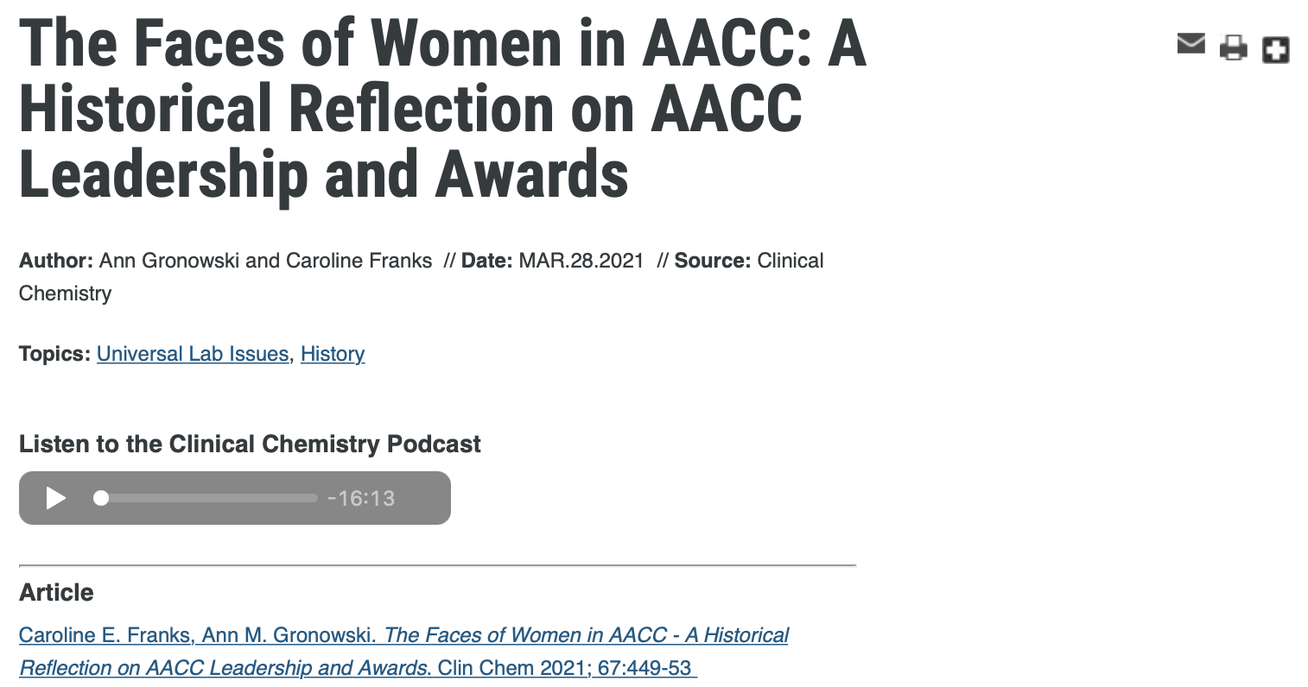
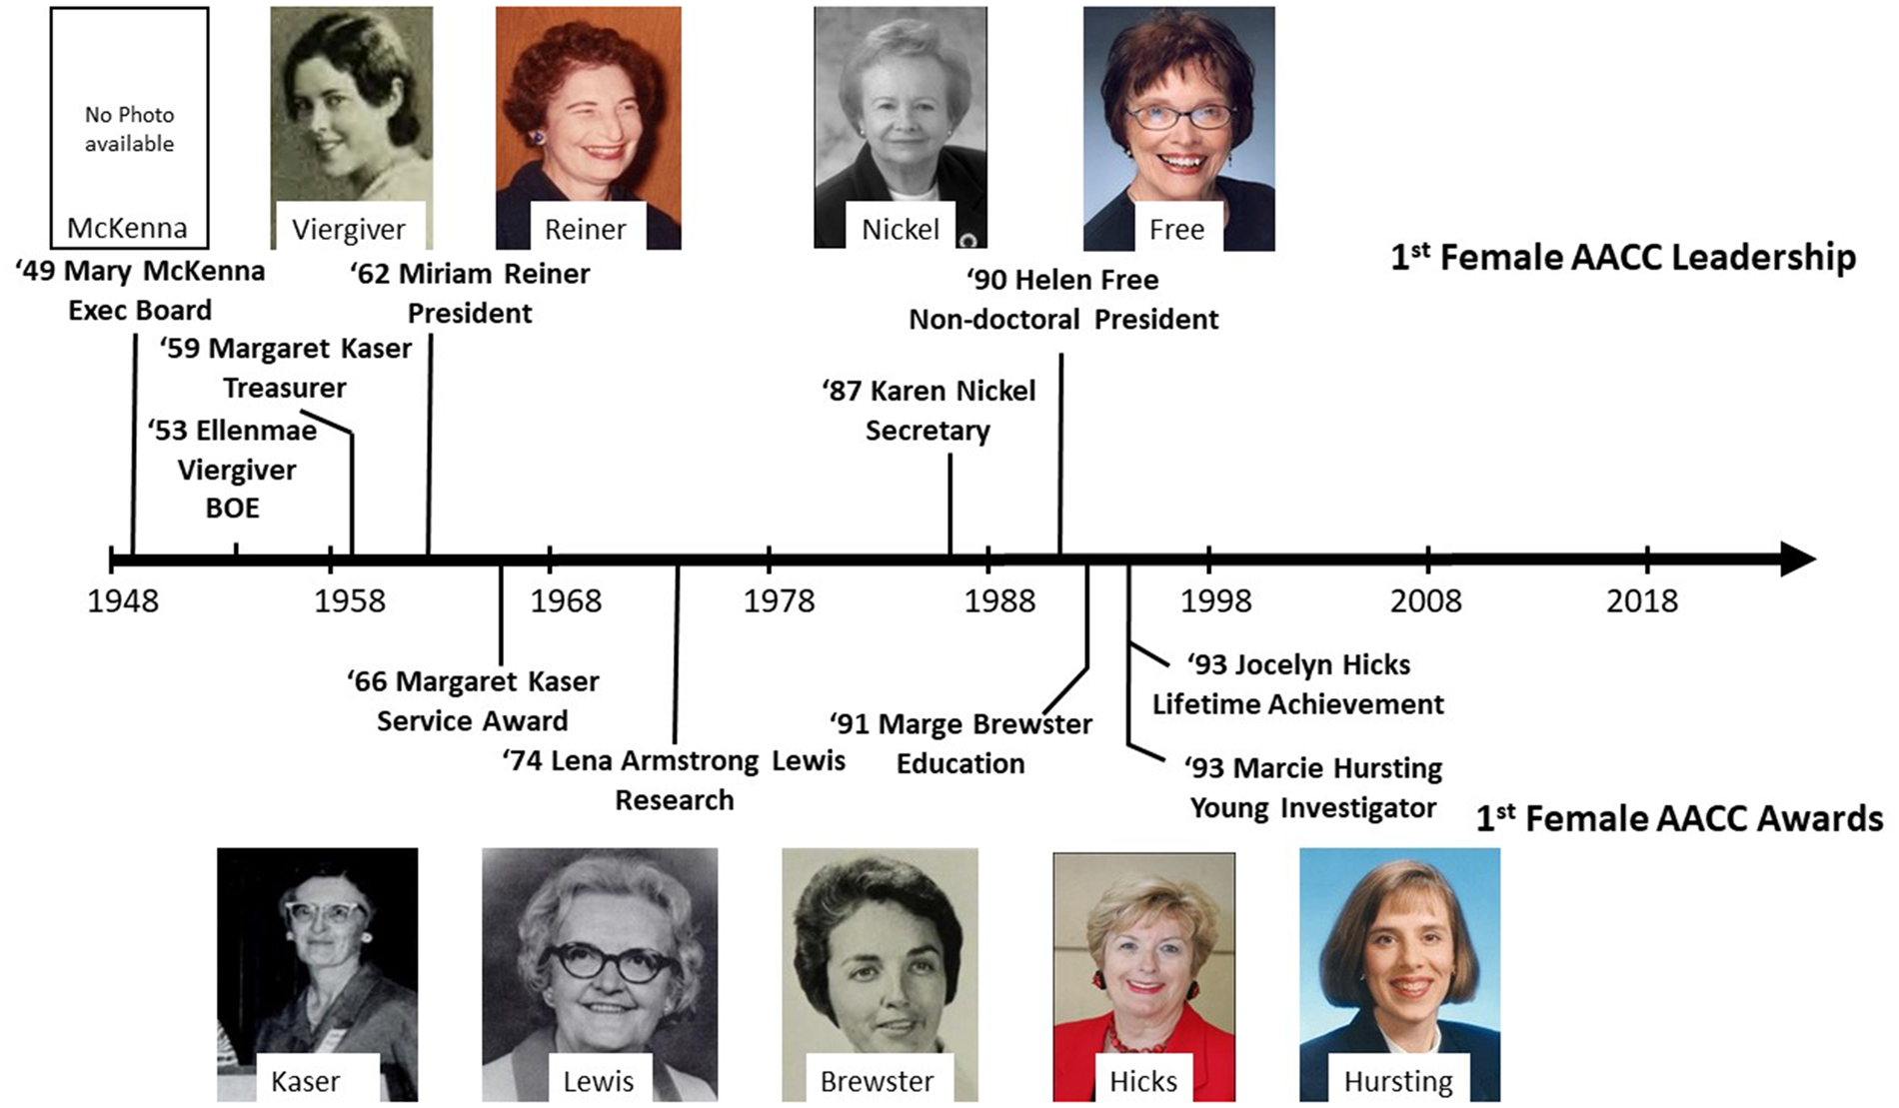
Clinical Chemistry Podcasts

Slide 7
Clinical Chemistry Trainee Council
Clinical Chemistry Guide to Scientific Writing
Pearls of Lab medicine
Webcasts
Clinical Chemistry Podcasts
The Journal Club
Inspiring Minds
https://www.aacc.org/science-and-research/clinical-chemistry-trainee-council

Slide 8
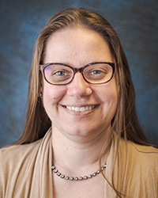
Danyel Tacker, PhD, D(ABCC)
Associate Clinical Professor of Pathology, West Virginia University
Section Director, Chemistry & Clinical Mass Spectrometry Laboratories CLIA Director, Blood-Gas Testing/Laboratory WVU Hospital, Morgantown, WV
CLIA Director, Laboratory WVU Hospitals Fairmont Medical Center, Fairmont, WV

Slide 9
Clinical Laboratory News
Ask the Expert
Bench Matters
The Sample
CLN feature story: CE-earning & recruited by the Board of Editors
CLN Daily at the annual meeting
CLN BoE membership (volunteer page, aacc.org; selected by BoE Chair, appointed by acting AACC President)
Visibility: many of these pieces are featured via CLN STAT electronic newsletters, the circulation is high (42k print, >75k electronic as of Q1 2021)
Ideas: pitched through contact with Staff Editor, Bill Malone (contact us page)
https://www.aacc.org/cln

Slide 10
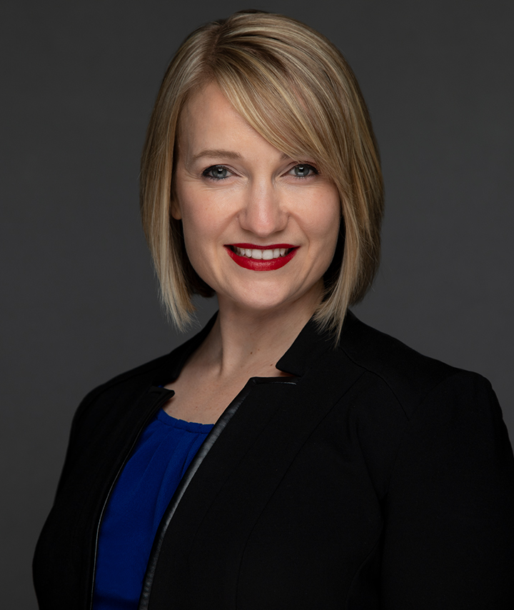
Sarah Wheeler, PhD, FAACC
Assistant Professor of Pathology, University of Pittsburgh
Associate Medical Director, Clinical Immunopathology, UPMC
Medical Director, Automated Laboratory, UPC Mercy and UPMC Children’s Hospital of Pittsburgh

Slide 11
AACC Academy
Scientific Shorts
4 ACCENT credits to authors
Ideas are reviewed by the editorial board monthly
Submit ideas for posts to Stefanie Kleinman (skleinman@aacc.org), please also state that you are a SYCL member
Guidance Documents
Most recent document: AACC Guidance Document on Point-of-Care Testing Management
If you are interested in proposing a specific topic, please review the Guidance Document Standard Operating Procedures on how to get started.
https://www.aacc.org/community/aacc-academy

Slide 12
Alec Saitman, PhD, DABCC (CC, TC)
Editorial Board Member, CFTN
Technical Laboratory Director Core Laboratory, Associate Director of Quality
Providence, St Joseph Health

Slide 13
Clinical and Forensic Toxicology News
Established in March 1988
We just turned 34!
One of AACC’s longest running publications!
Formally known as “Forensic Urine Drug Testing Educational Newsletter”
Issues are released quarterly and consists of 3 articles
Feature article 2,500 to 3,000 words
Medium article 1,000 to 1,500 words
Small article 500 to 700 words
https://www.aacc.org/science-and-research/clinical-and-forensic-toxicology-news

Slide 14
Clinical and Forensic Toxicology News
Recent articles!
A Short Review of Nerve Agents
Update on Psychedelic-Assisted Therapies for Mental Health
Increasing Trends of Drug Abuse and Overdose Deaths Driven by a Global Pandemic
FDA Alerts Consumers to Toxic Hand Sanitizers
Testing Urine for Drugs of Abuse during a Pandemic
2020 AACC Annual Scientific Meeting: Virtual Scientific Events Showcase Toxicology through a Multi-Disciplinary Lens
https://www.aacc.org/science-and-research/clinical-and-forensic-toxicology-news

Slide 15
Clinical and Forensic Toxicology News
Editorial board identifies content, article length and solicits potential authors
We are always looking for authors to help write these articles
Topic suggestions for future publication are always encouraged
Many times, we ask the individual to write the article who made the suggestion
https://www.aacc.org/science-and-research/clinical-and-forensic-toxicology-news

Slide 16
Clinical and Forensic Toxicology News
Submission and review process is straightforward and expeditious
Excellent way to build up publication history
Especially for individuals interested in toxicology related laboratory medicine
https://www.aacc.org/science-and-research/clinical-and-forensic-toxicology-news

Slide 17
Nicole V. Tolan, PhD, DABCC
Associate Editor, JALM
Assistant Professor of Pathology, Harvard Medical School
Associate Medical Director of Clinical Chemistry and Medical Director of POCT, Brigham and Women’s Hospital, Boston, MA

Slide 18
Journal of Applied Laboratory Medicine
Case Reports
Focused Reports
Laboratory Reflections
Mini-Review & Review
Point/Counterpoint
Editorial
Special reports
AACC Academy Guidance Documents
SYCL Salary Survey
Research or Scientific Article
Training
Early-Career
Mid-Career
Established Research and Expertise
https://academic.oup.com/jalm

Slide 19
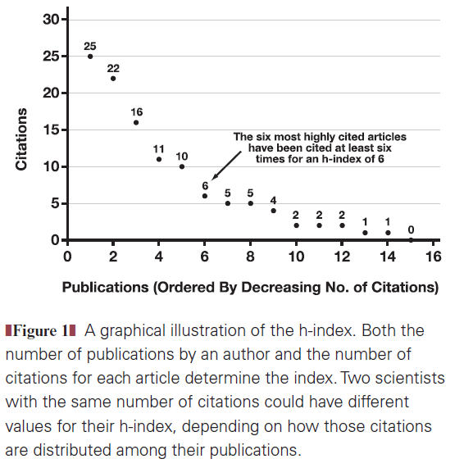
What is the author citation h-index?
Author-level metric that measures the number and citation impact of the publications of a scientist or scholar; used in the assessment of performance for professional advancement
The h-index is defined as the maximum value of h: the number of papers h with a citation number ≥h
Quantity
Quality/Visibility
Schreiber and Giustini AJCP2019;151:286-91

Slide 20
Laboratory Reflections
Mini-Review/Review
Technical Tips: practical solutions to technical challenges and unmet needs
Pay it Forward: advice, experience, and resources for mentoring, training, teaching, having visitors in your laboratory, and contact with others in the field.
Professional Insights: contributions from forward-thinking individuals in the field who wish to share their vision, intuitions, experience, and perceptions in lab med
Vathany Kulasingam (Dr.Vathany.Kulasingam@uhn.ca)
Mini-Reviews: intended to provide a general overview of a topic. Basic information is provided, along with selected references that can aid the reader in obtaining additional information about the subject.
Reviews: intended to provide comprehensive coverage of a topic, including background clinical or analytical information, the relevance and importance of the subject matter, and potential future directions.
Deb French (Deborah.French@ucsf.edu)
https://academic.oup.com/jalm/pages/general_instructions#Types%20of%20Submissions

Slide 21
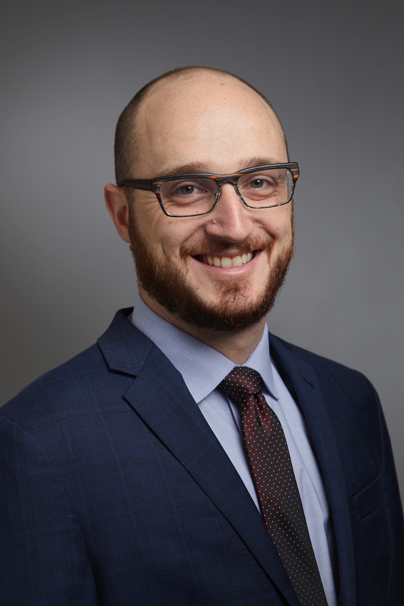
Joe El-Khoury, PhD, DABCC, FAACC
Associate Editor, Social Media Editor, Clinical Chemistry
Associate Professor of Laboratory Medicine, Yale School of Medicine
Director, Clinical Chemistry Laboratory, Yale-New Haven Health
Co-Director, Clinical Chemistry Fellowship Program, YNHH
@ClinChemJoe

Slide 22
Clinical Chemistry
Letter to the editor
Clinical Chemist
News and Views
Unveiling the right side
What’s your guess
Genetic metabolic series
Clinical toxicology series
Clinical Case Studies
Q&As
Research or Scientific Article
https://academic.oup.com/clinchem

Slide 23
Danyel Tacker, PhD, D(ABCC) (again ☺)
Associate Clinical Professor of Pathology, West Virginia University
Section Director, Chemistry & Clinical Mass Spectrometry Laboratories CLIA Director, Blood-Gas Testing/Laboratory WVU Hospital, Morgantown, WV
CLIA Director, Laboratory WVU Hospitals Fairmont Medical Center, Fairmont, WV

Slide 24
AACC/NEJM Knowledge⁺ Learning Lab
Partnership between AACC, NEJM, and Area9
Online, adaptive learning platform for phone, tablet, or “PC”-based learning
Originally a subscription-based model – now FREE, starting in 2021
Modules (courses) to be linked to upcoming Tietz revision
Areas of focus include: Chemistry, Molecular Diagnostics, Heme/Coag, Microbiology, Clinical Immunology
Join our pool of authors and reviewers! [Revise existing modules, create new ones, test…]
Connect via learninglabsupport@area9.dk
https://knowledgeplus.nejm.org/partner-programs/aacc-learning-lab/

Slide 25
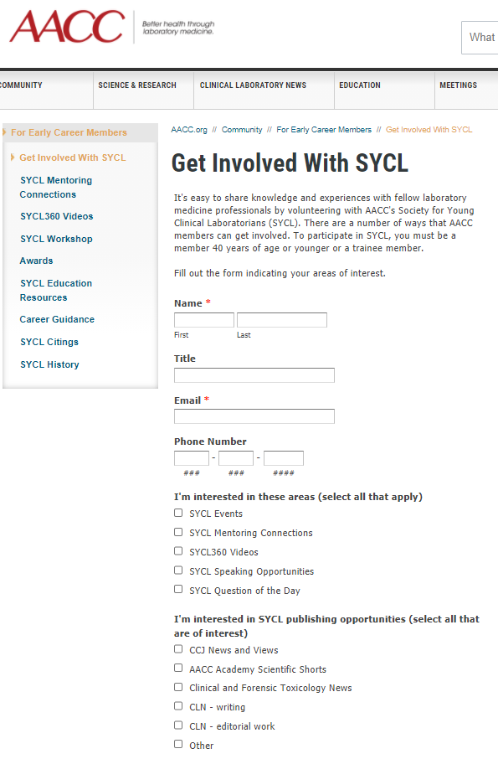
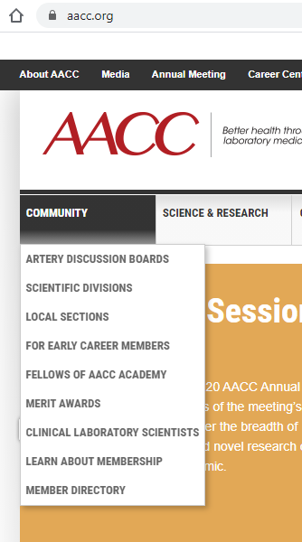
Interested in getting involved?

Slide 26
Q&A Session

